Slide 1
Starlite Recovery Center
Frank Valley MAC CCJS LCDC CAI
South Texas Business Development Manager
(361)-408-0275 fvalley@crchealth.com
www.starliterecovery.com

Slide 3
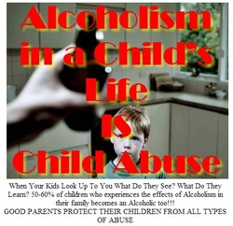

Slide 4
Children of alcoholics are at
higher-than-average risk for
developing substance use
problems, mental health
problems, and related
behavioral and social
problems.
(Anda et al., 2002;
Lieberman, 2000)

Slide 5
Statistical Facts:
About 43% of U.S. adults — 76 million people — have been exposed to alcoholism in the family — they grew up with or married an alcoholic or a problem drinker or had a blood relative who was an alcoholic or problem drinker.
An estimated 6.6 million children under 18 live in households with at least one alcoholic parent.
About 43% of adults in the US (76 million people) have had a parent, child, sibling or spouse who is or was an alcoholic.
Currently, nearly 14 million Americans adults-abuse alcohol or are alcoholic. Several million more adults engage in risky drinking patterns that could lead to drug addiction. In addition, approximately 53% of men and women in the United States report that one or more of their close relatives have a drinking problem.
One-half of all traffic fatalities and one-third of all traffic injuries are related to the abuse of alcohol. Accidents and suicides that are associated with alcohol problems are especially prominent in the teen years.

Slide 6
Region 11, 2014 Texas School Survey findings
43.7% of students have used alcohol in the past and 19% had been using alcohol in the past month from the time the survey was administered.
Students reported that beer (33.3%) consumption is highest than other alcohol products.
In Texas, 46.5% had ever used alcohol and 19.1% had used in the past month. Beer was the choice preference by 35%.
In Region 11, 8.5% of 12th graders reported to having 5 or more drinks of alcohol at one time during the past day.

Slide 7
Notes:
Lets talk about “The Family of Addiction”

Slide 8
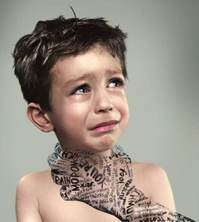
Notes:
It is like a Choke hold on every member of the family

Slide 9
Often, the people hurt most by alcohol abuse and
alcoholism don’t even drink; they are the children of
alcoholic parents.
These children are more likely to experience mental and physical problems and are at a greater risk of being neglected and/or abused.
Children of alcoholics are two to four times more likely than other children to become addicted to alcohol themselves.
Every community experiences the devastating effects of
alcoholism on children. Together, we can break the cycle
of alcohol problems in families

Slide 10
How many children of alcoholics are there?
• More than 6 million children live with at least one parent who abuses or is dependent on alcohol or an illicit drug.
Why should we be concerned about children of alcoholics?
• Alcoholism tends to run in families. Children of alcoholics (COAs) are four times more likely than non-COAs to develop alcoholism or drug problems.
COAs are at higher risk than others for depression, anxiety disorders, problems with cognitive and verbal skills, and parental abuse or neglect.
They are significantly more likely than other children to be abused or neglected by their parents or guardians and are more likely to enter
foster care.
• If not prevented, the difficulties faced by COAs can place increased burdens on State and local Governments. These include increased costs for health care, mental health services, child welfare, education, police and juvenile justice, and lost economic opportunity.
•

Slide 11
How are families with alcoholism different from other families?
Families with alcoholism have higher levels of conflict than other families.
Lack of adequate parenting and poor home management and family communication skills often leave children without effective training and role modeling.
Families with alcoholism often lack structure and discipline for their children; as a result, the children often are expected to take on responsibilities normally assigned to older youth or adults

Slide 12
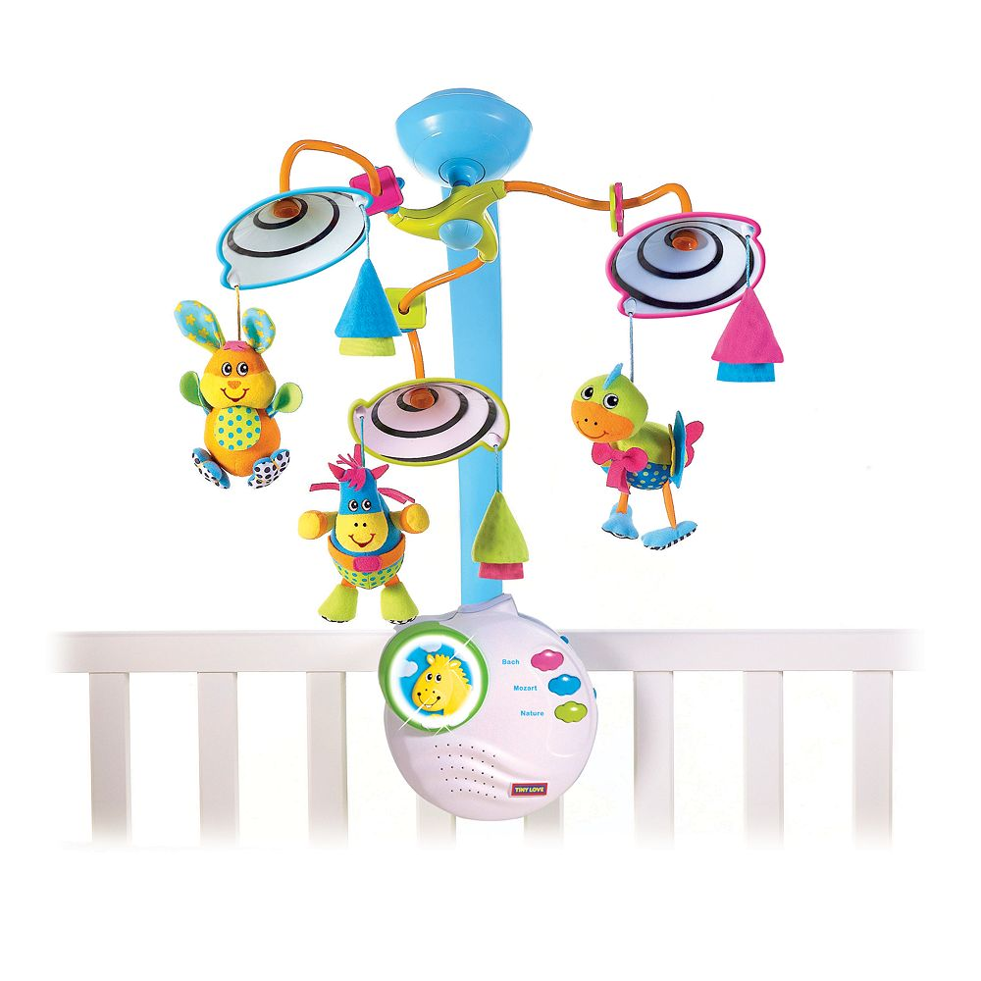

Slide 18
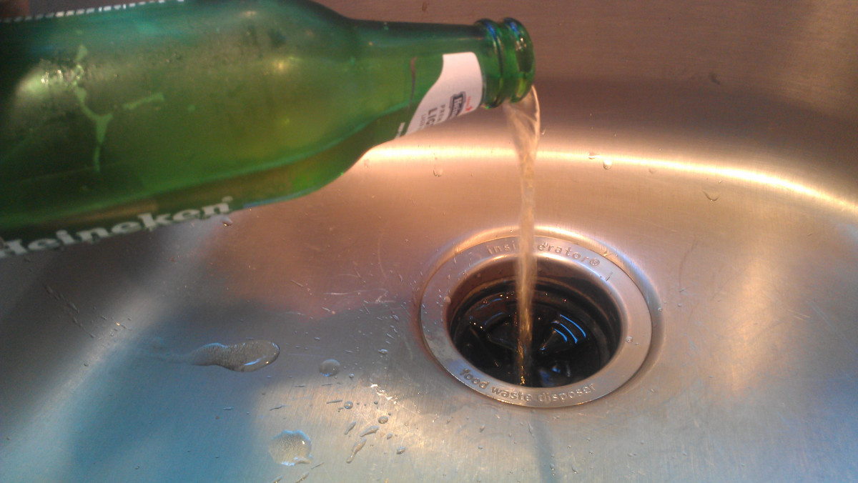

Slide 38
Family Mascot
Often is the youngest child in the family
Develop a dire need for approval from others
Viewed as the most fragile and vulnerable
Behaviors are an act of defense against feelings of anxiety and inadequacy
As adults they tend to be very likeable but often appear anxious
May self-medicate with alcohol and/or tranquilizers
May be the one family member that nobody complains about

Slide 48
How can we help prevent children of alcoholics from repeating their families’ alcohol-related problems?
• Although they are at increased risk, many COAs do not develop alcohol or drug use disorders or other serious problems in their lives. Often, they appear to be resilient, bolstered by protective factors and the support of caring adults in their
• COAs can be helped, whether or not the alcohol-abusing family members are receiving help. Prevention programs often help COAs reduce stress; deal with emotional issues; and develop self-esteem, coping skills, and social support.8
• Children who cope effectively with alcoholism in their families often rely on support from a nonalcoholic parent, grandparent, teacher, or other caring adult. Support groups, faith communities, and trained professionals also are available.

Slide 50
What can others do to help children of alcoholics avoid alcohol abuse and other serious problems?
• Simple acts of kindness and compassion can make a difference for COAs. By making yourself available to listen, discuss feelings, share interests, and support their efforts to make friends, you can help COAs cope with their present situations and develop the resilience and skills necessary for their futures.11
• Tell them they are not alone, that responsible adults are available to help them, and that millions of others have had similar experiences and have grown up to lead healthy, satisfying lives.
• Remind them that their families’ problems are not their fault and not their responsibility to solve. Their jobs are to be children and help take good care of themselves; learn the facts about alcohol, tobacco, and drugs; recognize their risks; and learn how to avoid repeating their families’ alcohol abuse patterns.10
• Encourage them to ask for help. Assure them that getting help is a sign of strength. Offer your own examples and be prepared to help them connect with caring, trustworthy adults and with student assistance programs and other services designed to provide them with further skill building and support.10
• Help break through the barriers of shame, silence, and isolation to help these children live healthy, happy lives—despite their family problems.

Slide 51
THERE IS HOPE AND HEALING
Who are the Addicts in Recovery?
Who are our Chief Enablers in Recovery?
Who are our Family Heroes in Recovery?
Who are Family Scapegoats in Recovery?
Who are Our Lost Children in Recovery?
Who are our Mascots in Recovery?

